Slide 1
CS-542 Project
LINK-STATE ROUTING SIMULATOR
Goutham MUGULUVALLI NIRANJAN
A20391757

Slide 2
Outline
Overview
Flow Chart
Simulator output
Dijkstra’s Algorithm
Pros and cons of Link-Stating routing protocol

Slide 3
Overview
One of two main classes of routing protocols used in packet switching networks for computer communications
Performed by every switching node in the network
Every node creates a routing table using Dijkstra’s algorithm
For link-state routing, a network is modelled as a directed weighted graph
Link-state router tells all other routers about only its neighbours and links
Each link (interface) is assigned a cost

Slide 4
Start
Flow Chart
Display menu and prompt for user input
Valid input
No
No
Yes
Selects exit
Proceed and perform the selected task and show menu
Yes
Stop

Slide 5
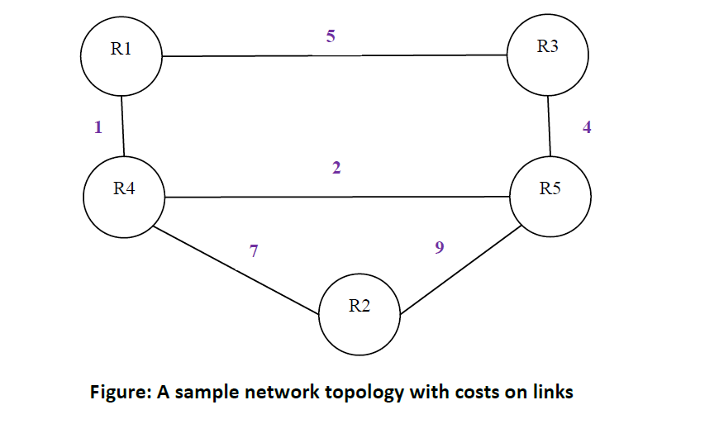
Network topology
Network topology used for demo
Each link between the two nodes may have different costs by direction

Slide 6

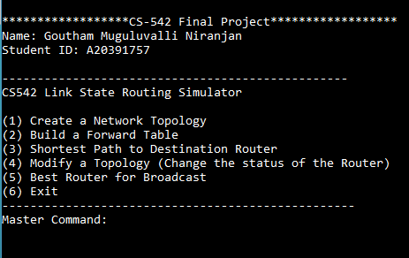
Menu screen
Execute the program with command – java Link_State
This will run the program and display menu for user
user will be asked to enter a valid choice from the menu

Slide 7
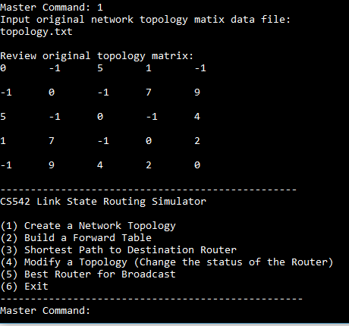
Create network topology
Topology matrix will be displayed and automatically return to menu
If input file is not correct, then user will be asked to enter the correct file again

Slide 8
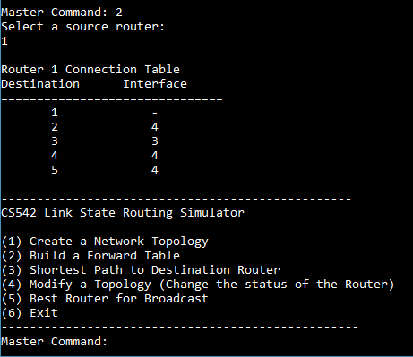
Connection table
With user input choice 2, a prompt will appear asking to enter source router to create connection table
If the source router is valid or is not deleted from the network a successful connection table will be created
If source router is invalid or deleted, then user will be asked to enter the correct source router

Slide 9
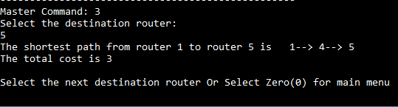
Shortest path and cost
With user input choice 3, a prompt will appear to enter destination router to find shortest path from source
Shortest path and cost will be shown
Prompts to enter next destination router or 0 for menu

Slide 10
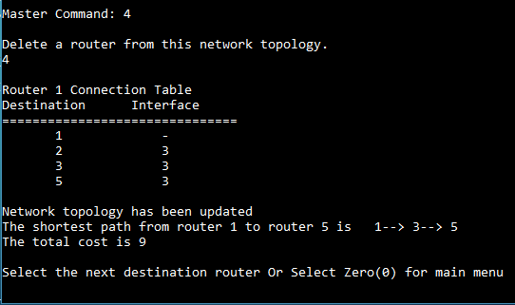
Modify network topology
With user input choice 4, a prompt will appear to enter router# which needs to be deleted
Updated connection table and revised shortest path is created automatically if the source and destination path was chosen by former last selection
If no former selection was done, then main menu will be displayed after the successful update of the topology

Slide 11
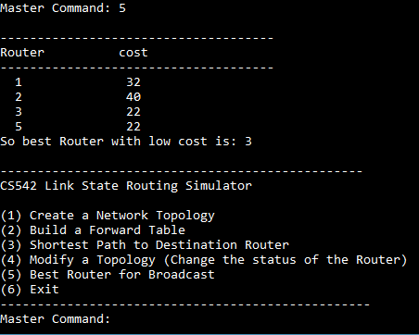
Best router
With user input choice 5, best router with low cost will be displayed and return to menu automatically.
If the topology was updated, then best router in updated topology will be shown as in this case because we deleted router 4
If topology was not changed then best router from the original topology will be shown

Slide 12
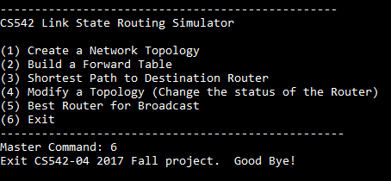
Exit routing simulator
With user input choice 6, program will terminate

Slide 13
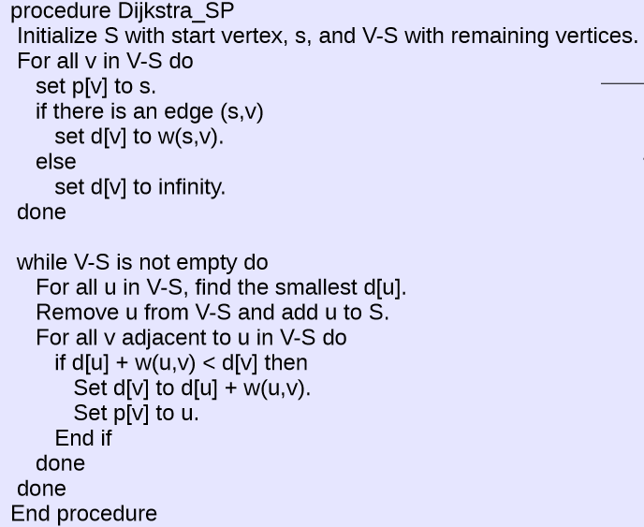
Dijkstra’s Algorithm
d[] is a simple array of cumulative distance from the source node to node under consideration
p[] is a simple array that holds the predecessor node for the node under consideration
w(u, v) is the cost of the path/link connecting nodes u and v
When the algorithm is done, the array element d[i] contains the shortest path from source to node represented by d[i], and the array element p[i] contains the predecessor node for the node represented by p[i]
Algorithm taken from CS-401 course material, taught by Prof. Vijay Gurbani in Spring 2017

Slide 14
Pros and cons of Link-Stating routing protocol
Pros:
Uses metrics (costs) to calculate path
Typically displays faster convergence than distance vector routing protocols
Typically more scalable due to hierarchical nature
Cons:
Require more memory to store state information, that is databases
Increased complexity in designing networks

